Slide 1
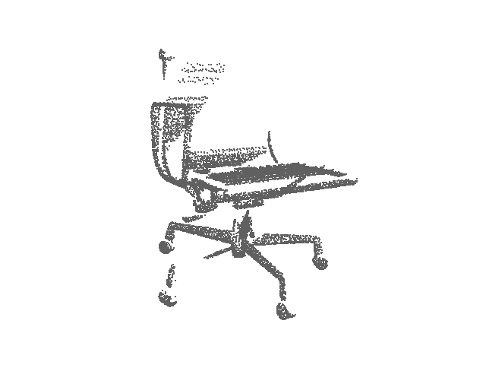
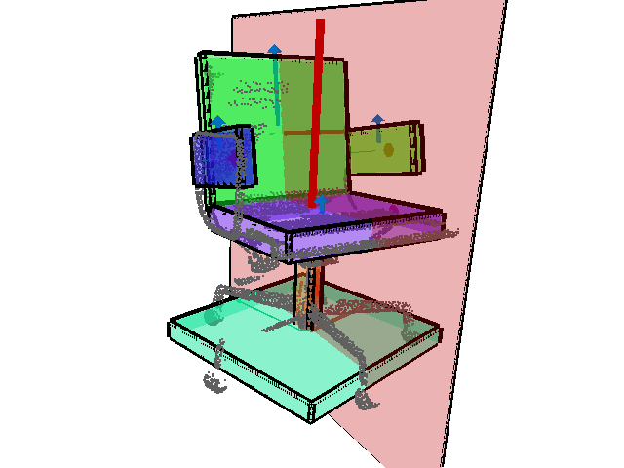
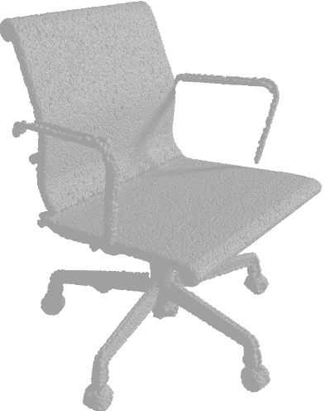
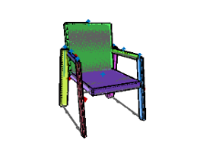
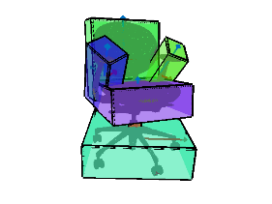
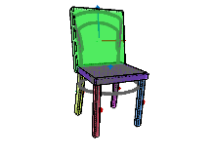
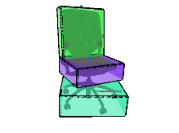




Data-Driven Structural Priors for Shape Completion
$$⋯$$
Minhyuk Sung¹ Vladimir G. Kim^{1,2} Roland Angst^{1,3} Leonidas Guibas¹ ¹Stanford University ²Adobe Research ³Max Planck Institute for Informatics
Notes:
Thank you for the introduction.
My name is Minhyuk Sung. I am going to talk about
Data-Driven Structural Priors for Shape Completion.
This is a joint work with Vladimir Kim, Roland Angst, and Leonidas Guibas.

Slide 2
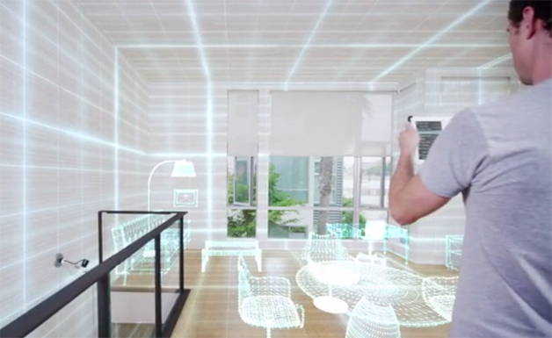
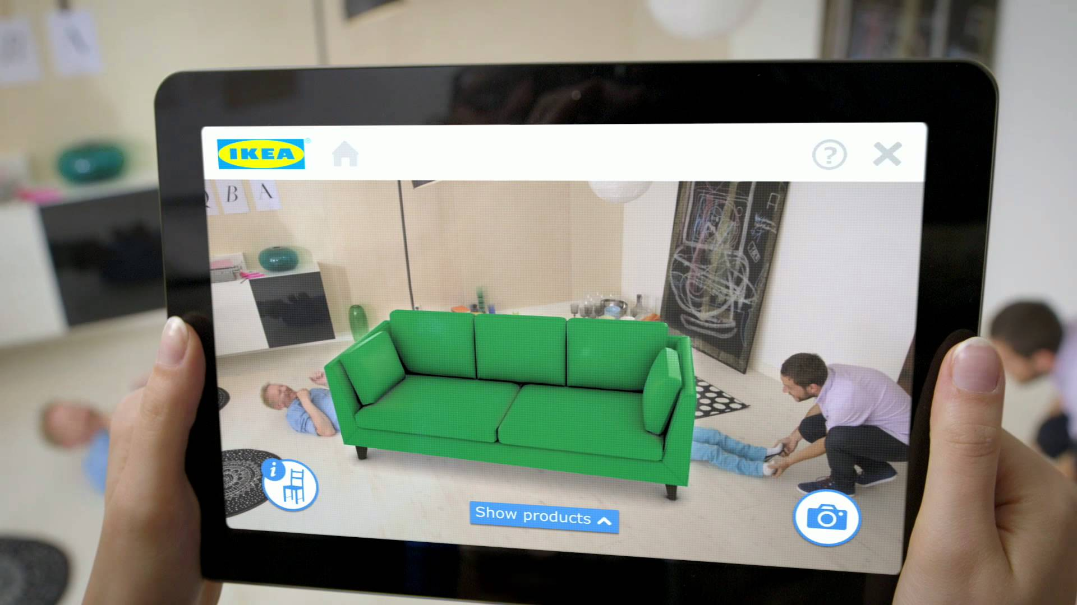
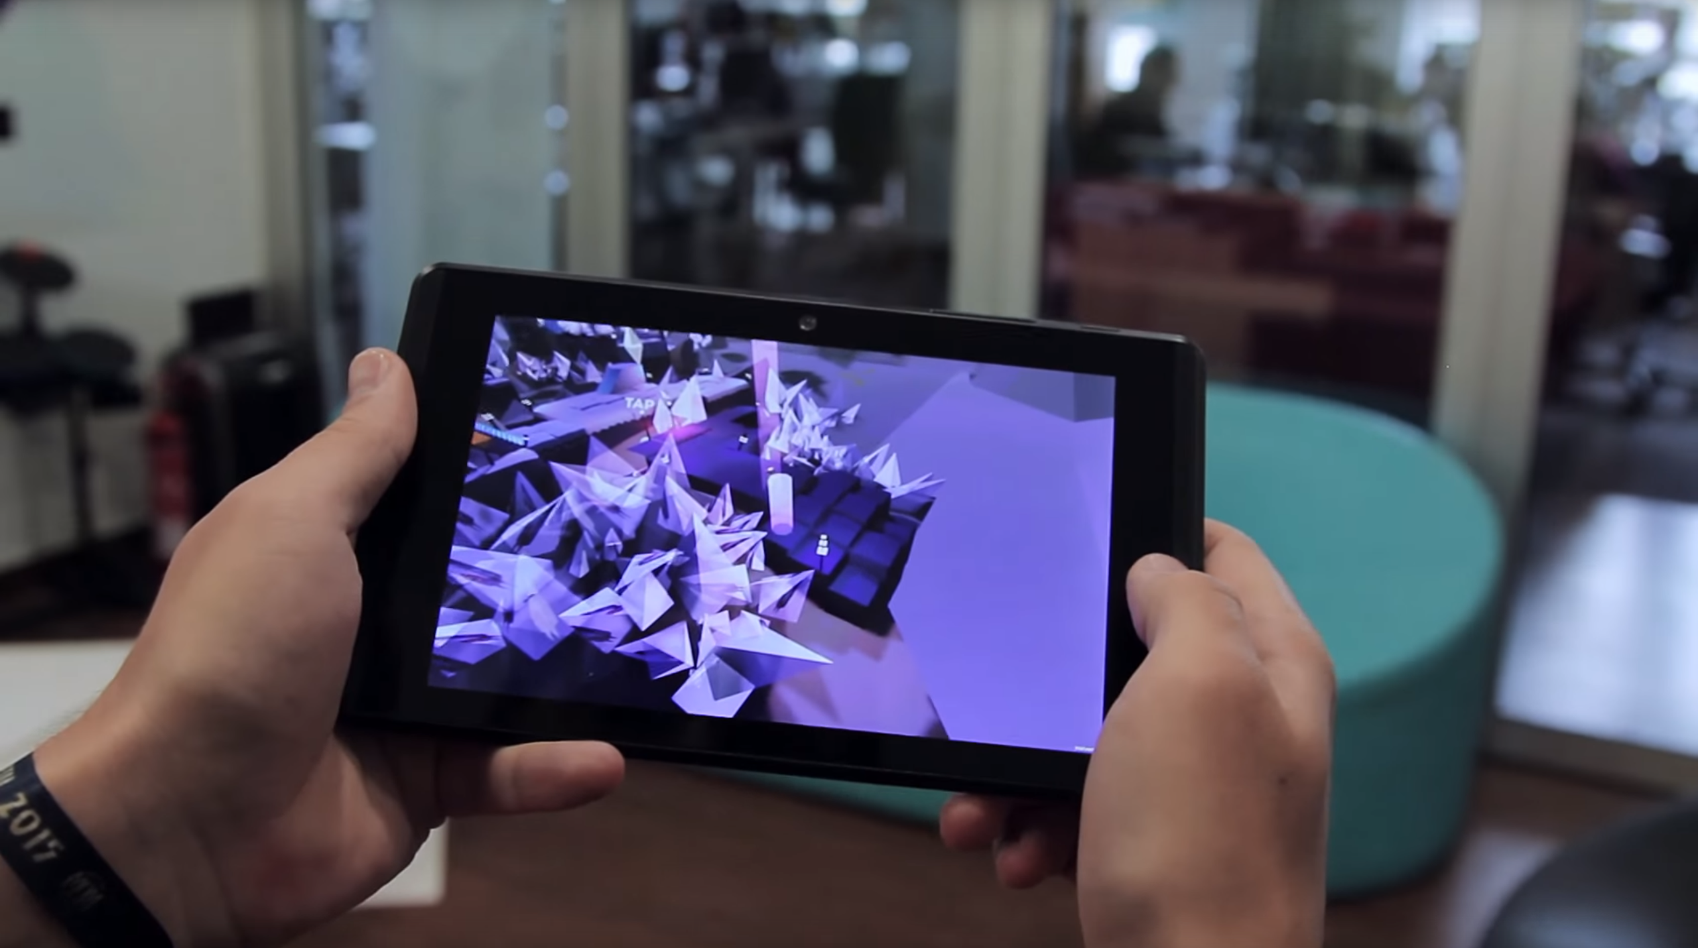
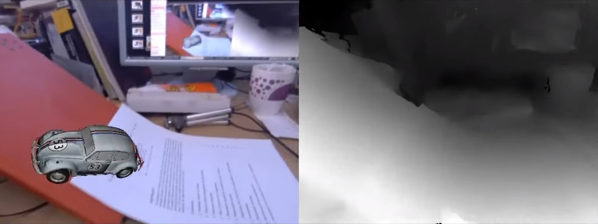
Motivation
Applications of 3D scanning
[IKEA]
[Structure Sensor]
[Newcombe et. al. 2011]
[Project Tango]
Notes:
Recent 3D scanning technology makes it possible to obtain spatial and geometric information from the real environment immediately.
And this captured information is used in many applications.
For example in augmented reality, we can place a virtual object in the real scene, to see how well it matches other real objects.
In games, we can also allow virtual characters to interact with a real environment.

Slide 3
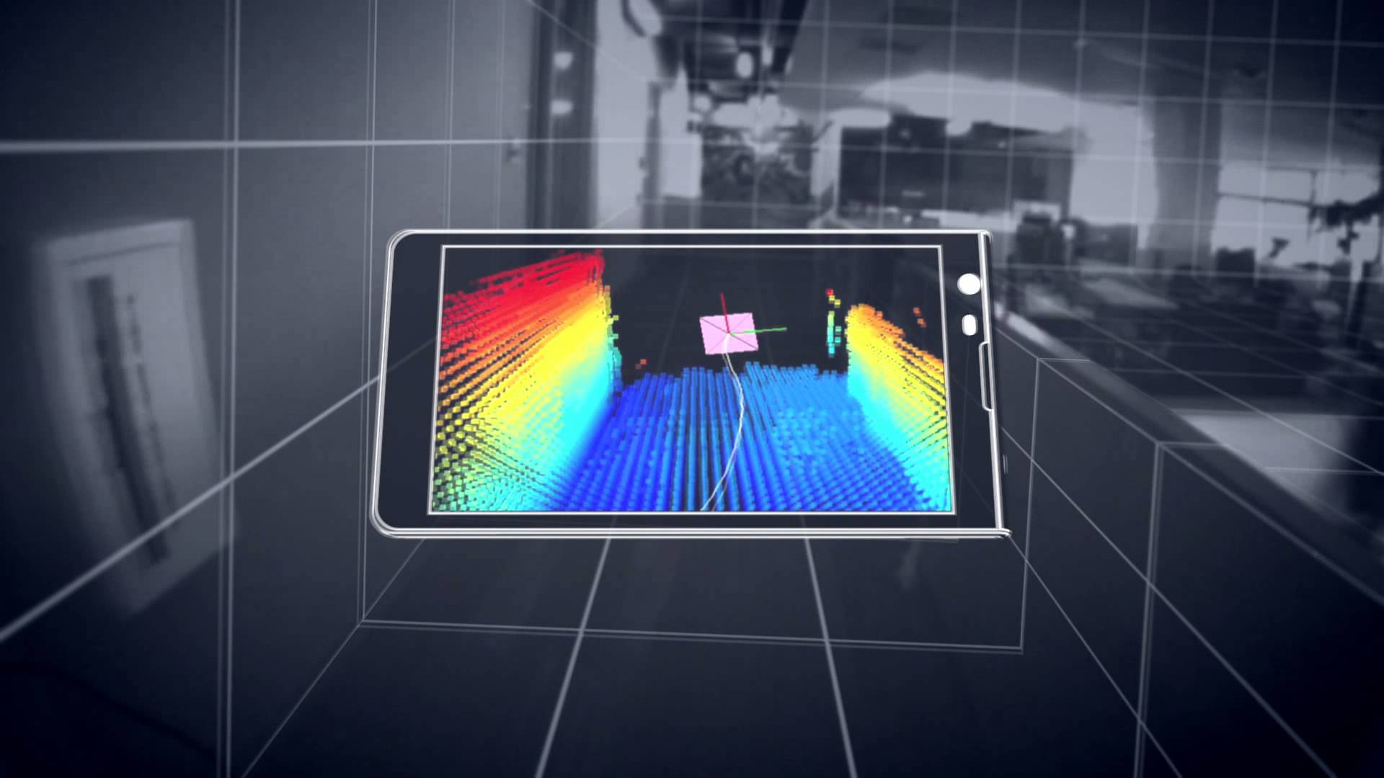
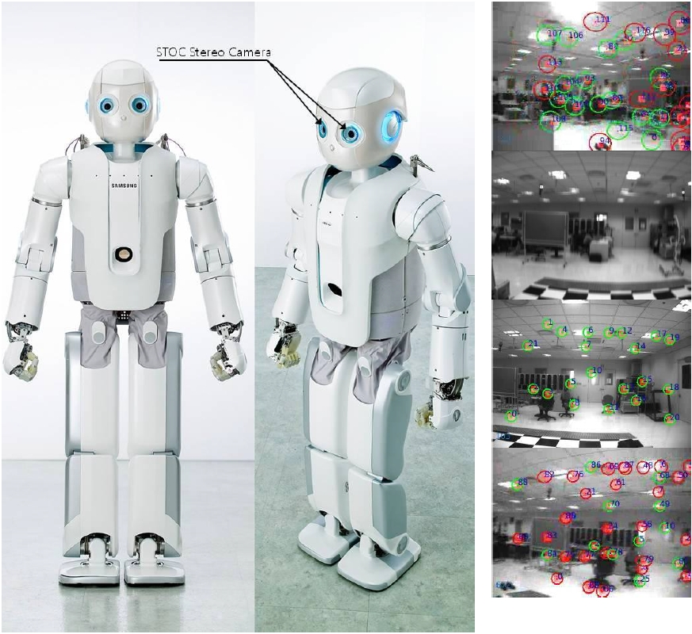
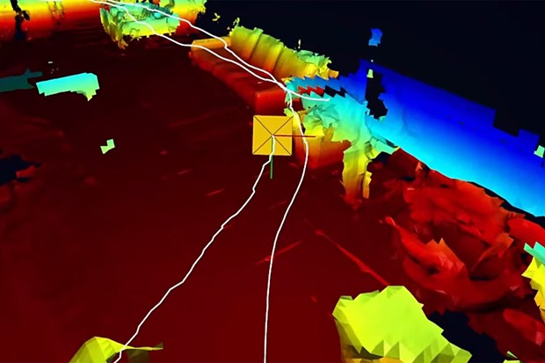
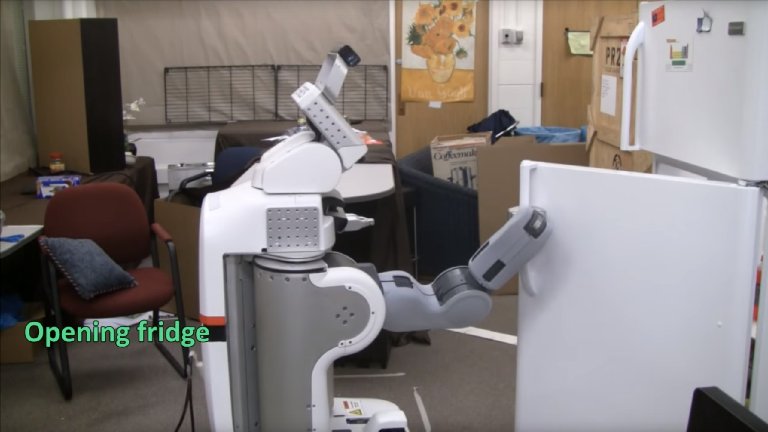
Motivation
Applications of 3D scanning
[Project Tango]
[Yoon et. al. 2013]
[Project Tango]
[Wu et. al. 2014]
Notes:
3D scanning is also an essential process in many robotics applications. For instance, using the spatial information captured by the scanners, robots can navigate space and create a map of the environment.
Also, combined with the color texture information, 3D scanned data is used to recognize objects and guide the robot on how to interact with them.

Slide 4

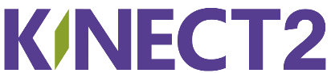
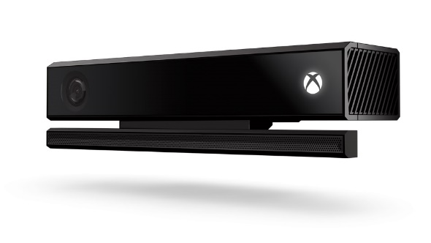
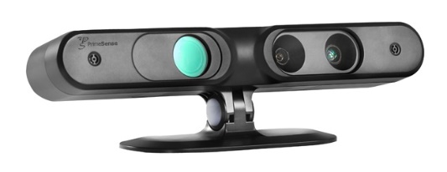
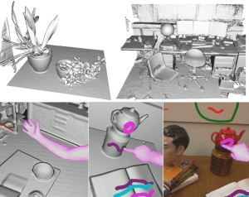
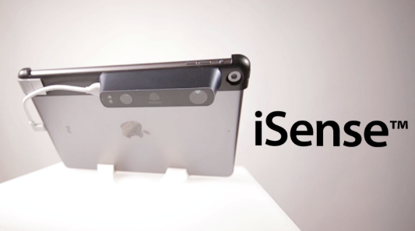





Motivation
Handheld 3D scanners
[KinectFusion]
Notes:
These applications became available because of the advent of small portable scanning devices such as Kinect.
Using these devices, recent technologies, including KinectFusion, have demonstrated great capability in reconstructing 3D information.

Slide 5
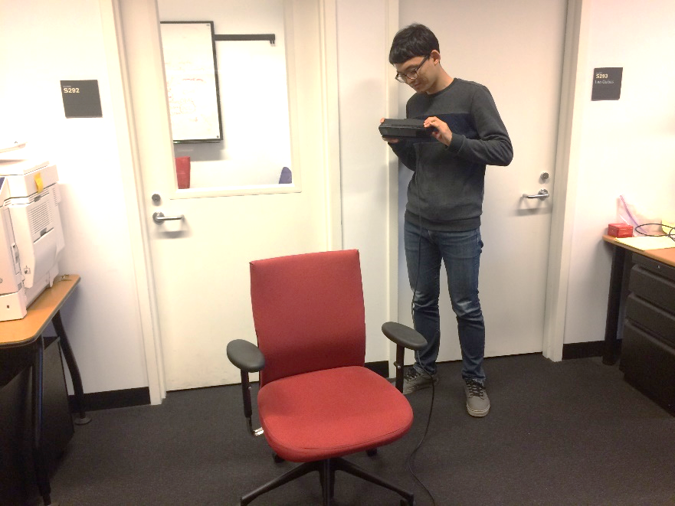
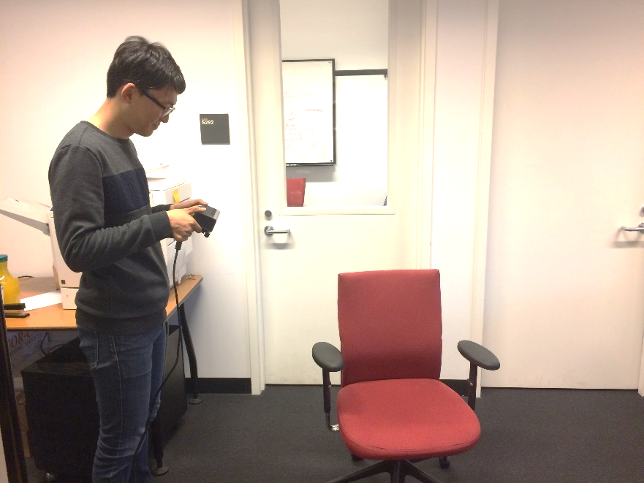
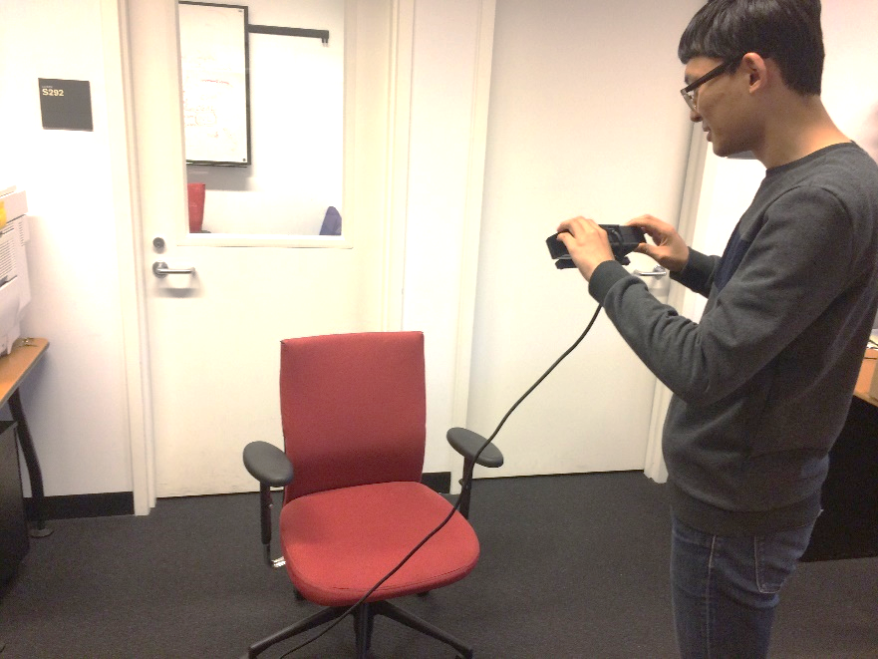
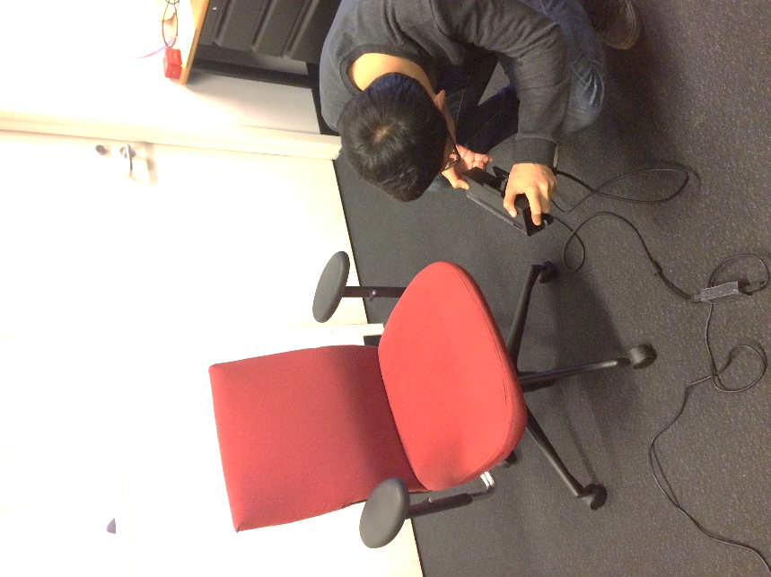
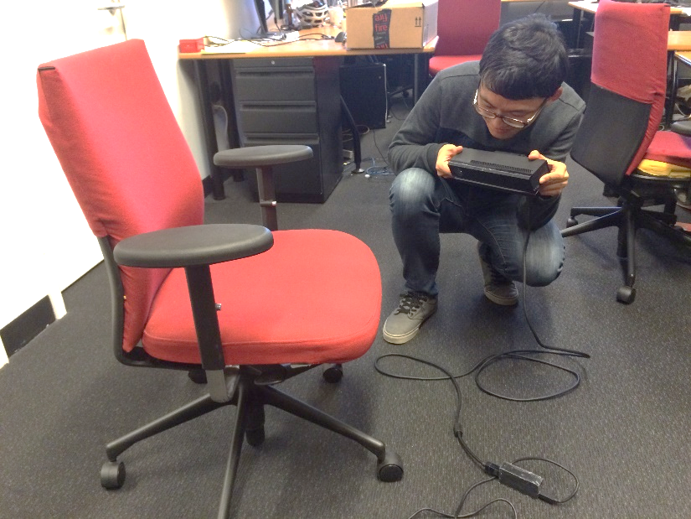
Motivation
3D scanning is laborious.
Notes:
But, 3D scanning an object is actually not a simple task.
All the handheld scanning devices capture a depth map from a single viewpoint.
This means,
[ANIMATION]
that the user has to capture depth maps from several different viewpoints, which are then merged into a single reconstruction.
Also because of occlusions, generally it is not possible to obtain the entire shape from sparse viewpoints, but actually the user needs to take care not to miss any small area in scanning.
Thus, 3D scanning an object is a tedious and error-prone task.
[ANIMATION]
The goal of our project is to introduce a new, simplified way of scanning using only a single viewpoint, (next slide)

Slide 6
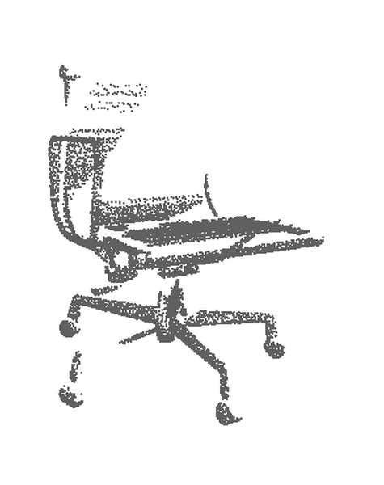
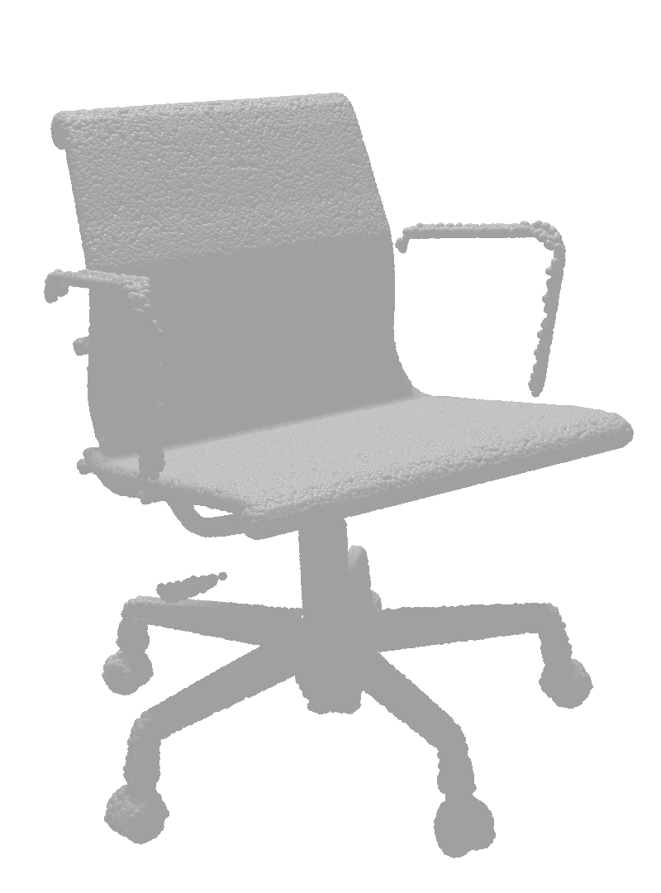
Goal
Complete shape from single view scan.
Notes:
So that the final result will provide the geometric information for the unobserved area, which will be useful for many scanning-related applications.

Slide 7
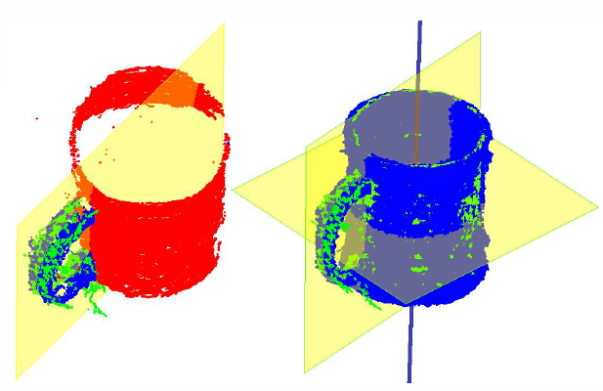
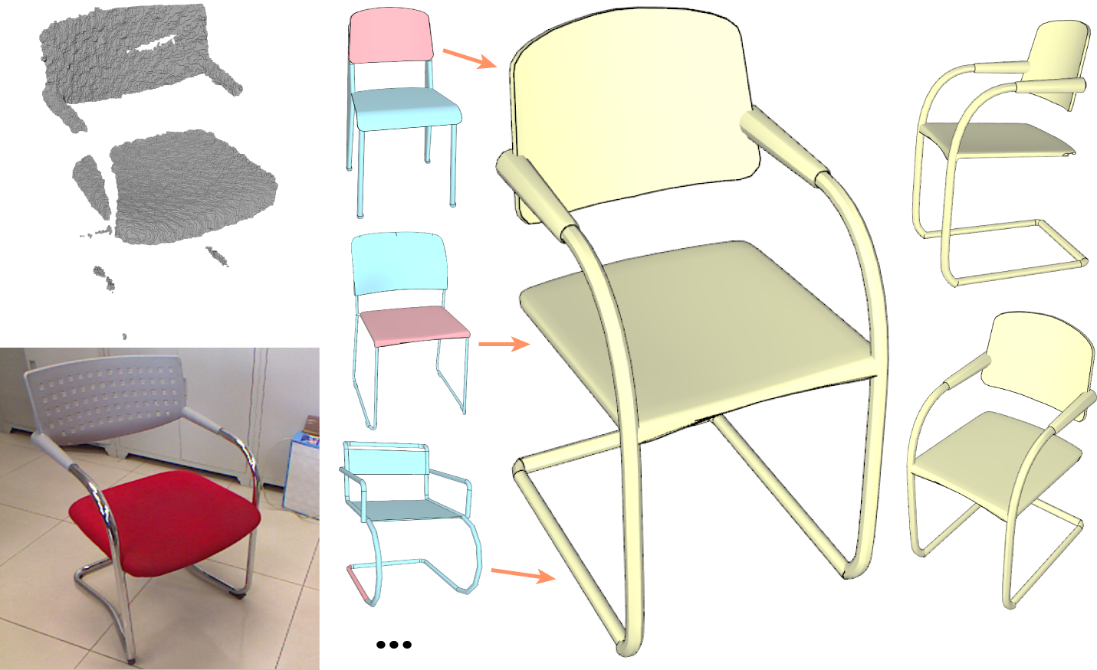
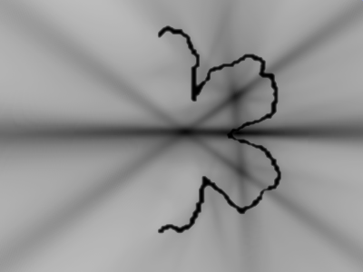
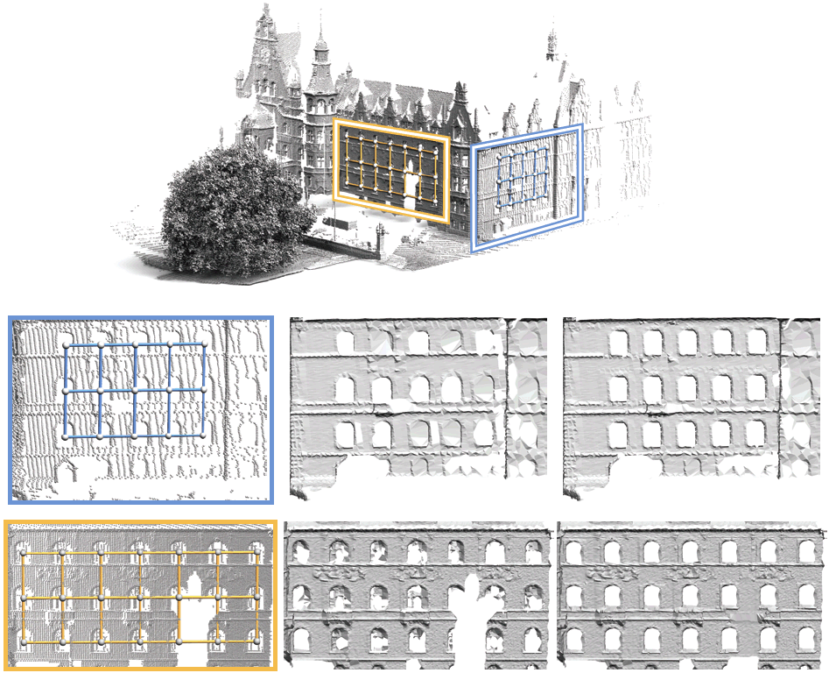
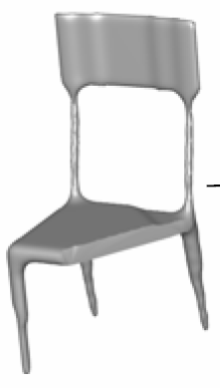
Related Work
Symmetry-based
Data-based
[Thrun el. al. 2005]
[Shen et. al. 2012]
[Podolak et. al. 2006]
[Pauly el. al. 2008]
[Sipiran et. al., 2014]
[Pauly el. al. 2005]
[Li et. al. 2015]
Notes:
(2m 20s)
Previous work has addressed this problem mainly from two directions.
The first one exploits symmetries present in the input scan, and uses the input data itself as a source to fill in missing information.
The other direction builds on a shape database, and predicts unobserved parts by retrieving a similar shape from that database.

Slide 8
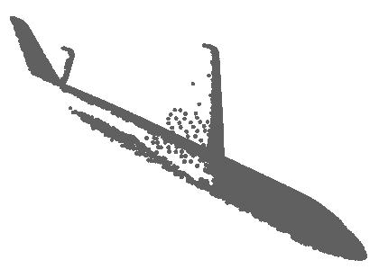
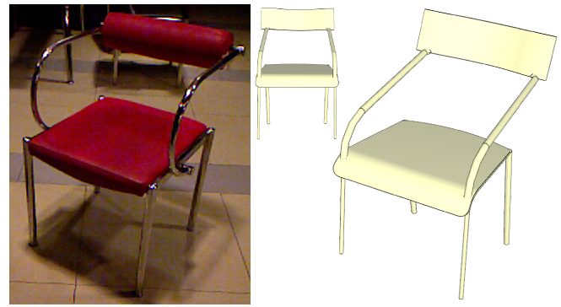
Related Work
Symmetry-based
Hard to predict from partial data.
Data-based
Hard to recover the exact shape.
Input Shape
Reconstruction
?
[Shen et. al. 2012]
Complementary!
Notes:
But neither of them is a perfect source for shape completion.
[Animation]
First of all, symmetry detection is not possible when a symmetric counterpart is completely missing.
In this figure, if there is only one wing of the airplane, it is hard to know that the original shape actually have a symmetry for left and right hand sides.
[Animation]
And also, data-based completion can reconstruct the exact shape only when there exist the same part in the database.
[Animation]
However, our observation is, that both approaches provide complementary information.

Slide 9
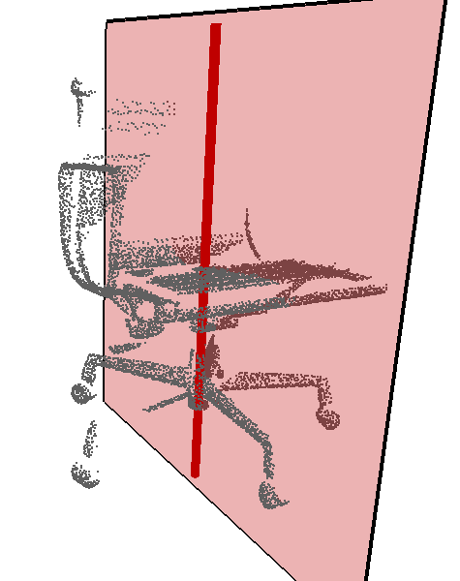
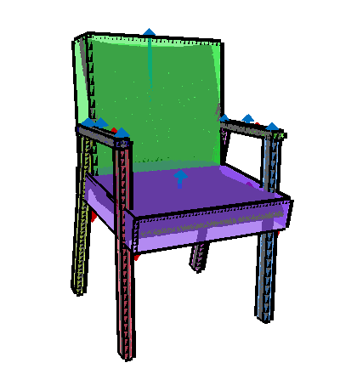
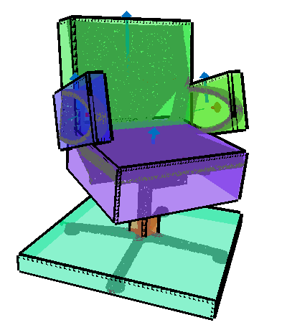
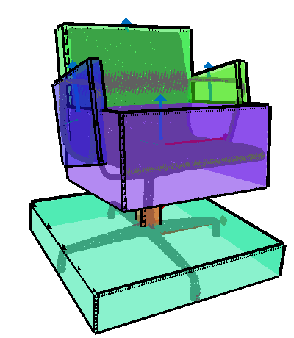
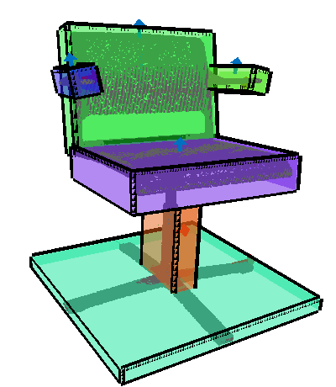
Key Idea
Combine both symmetry and database sources.
Reflectional Symmetry
Back
Armrest
Seat
Legs
Rotational Symmetry
Notes:
So, we aim to combine a database-assisted approach with symmetry detection,
so that we can achieve a better result to complete the missing area while preserving the original input shape as much as possible.

Slide 10
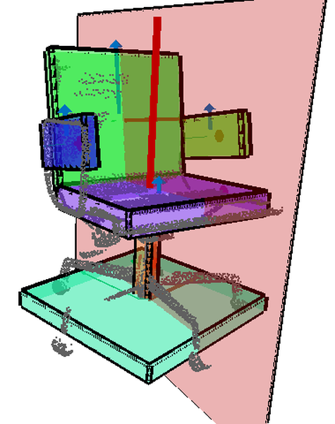




Our Approach
Estimate part and symmetry structure from the partial scan data using data-driven priors.
Back
Reflectional Symmetry
Armrest
Seat
Column
Training Data
Legs
$$⋯$$
Rotational Symmetry
Notes:
For this goal, we first estimate part and symmetry structure from the given partial scan data.
[ANIMATION]
We specifically use a 3D shape database with part annotations to learn the data-driven priors, and based on them,
[ANIMATION]
we capture both symmetry and part structures, which provide mappings to both, the input data itself, *and* to other 3D models in the database.

Slide 11
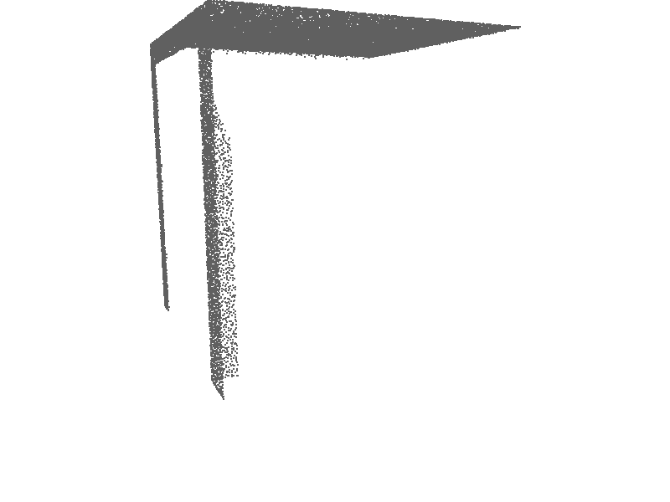
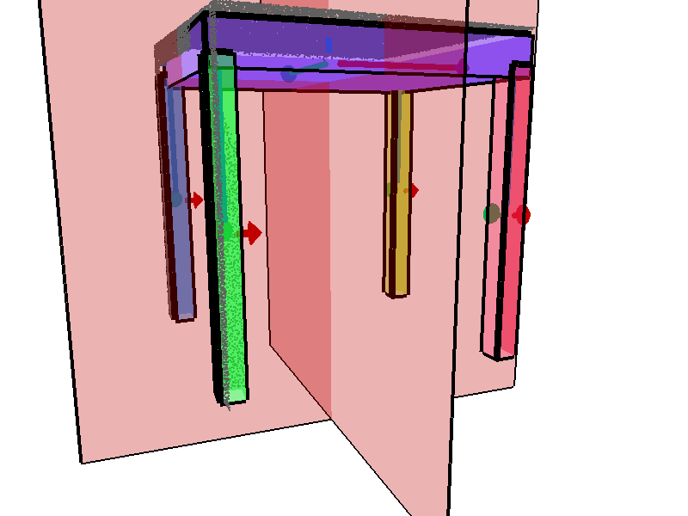
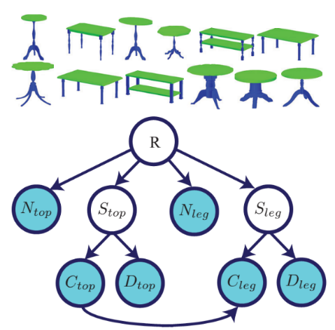
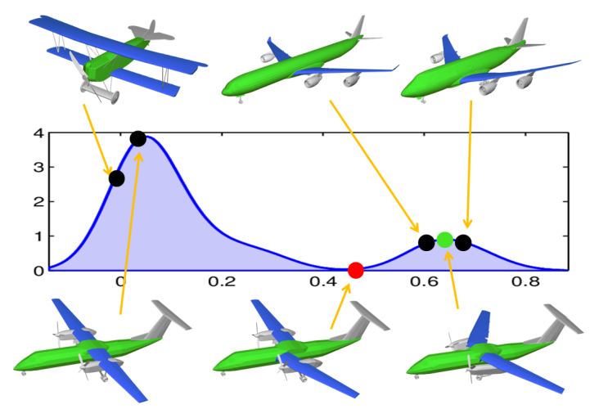
Our Approach
Predict missing parts based on part relations.
Analyze complete shapes only!
[Chaudhuri et. al. 2011]
[Kalogerakis et. al. 2012]
[Fish et. al. 2014]
[Kim et. al. 2013]
Notes:
Since we use data-driven priors, we can recognize some missing parts, and can detect correct symmetry even without any evidence of the symmetry in the input data.
This capability of recognizing missing parts comes from the fact that we define our structural priors based on the spatial relations among parts and their local coordinates.
[ANIMATION]
And this is the main difference with other previous work which introduce part-based shape model but analyze only complete shapes.

Slide 12
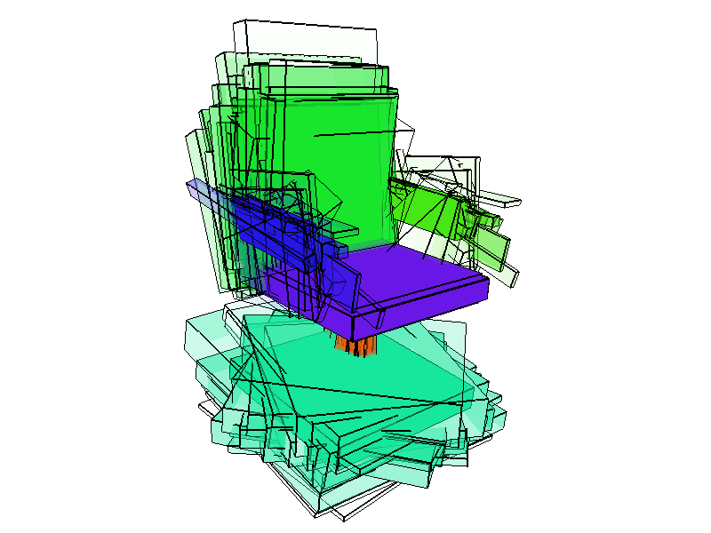

Outline
Probabilistic shape model
$$⋯$$
Training
A collection of 3D models with part annotations
Input
Output
Inference
Partial scan data
Input
Output
Part/symmetry structure including missing parts
Notes:
(4m 20s)
Now let me explain our approach.
In the training step, using a collection of 3D models with part annotations, we learn a probabilistic shape model.
And based on this, in the inference step, we predict part and symmetry structure including missing parts from the given partial scan data.
[ANIMATION]
Let me explain the training step in detail.

Slide 13
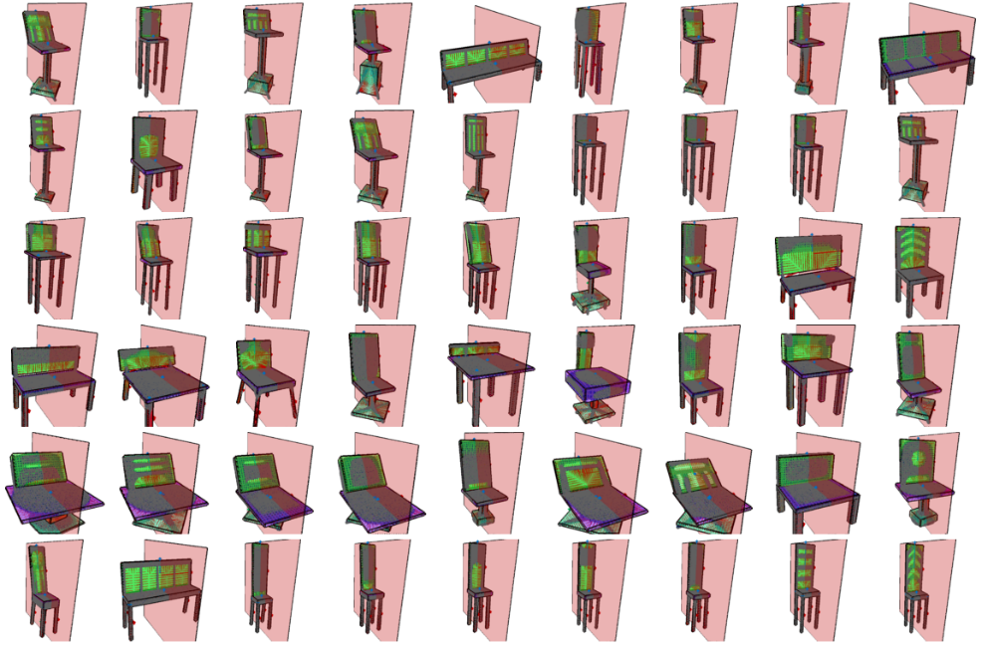
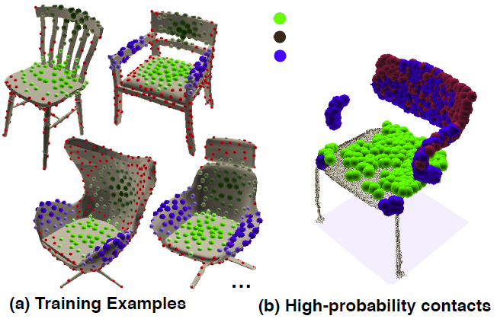
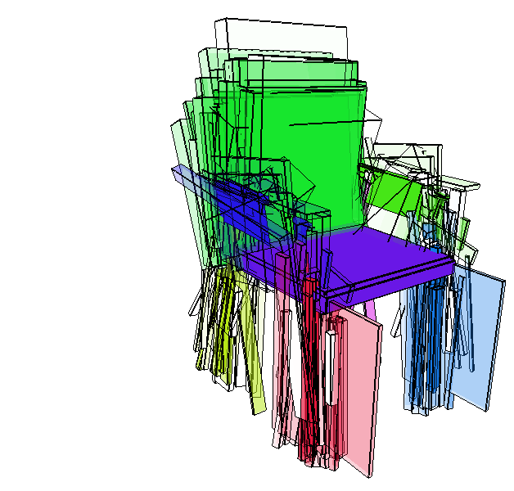
Training
Probabilistic shape model
Per-point classifiers
Pairwise part relations
Seat
Back
Armrest
[Kim et. al. 2014]
Notes:
Our probabilistic shape model includes two types of information.

Slide 14
Training
Probabilistic shape model
Per-point classifiers
Pairwise part relations
Seat
Back
Armrest
[Kim et. al. 2014]
Notes:
The first one is per-point classifiers based on local geometry.
For this part, we build a random forest classifier that predicts a part label based on local shape features.

Slide 15
Training
Probabilistic shape model
Per-point classifiers
Pairwise part relations
Seat
Back
Armrest
[Kim et. al. 2014]
Notes:
The next one, which is one of our main contributions, is pairwise part relations, which provide more structure-level information.
Let me explain this more.

Slide 16
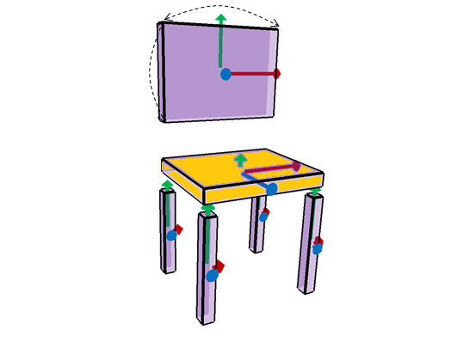
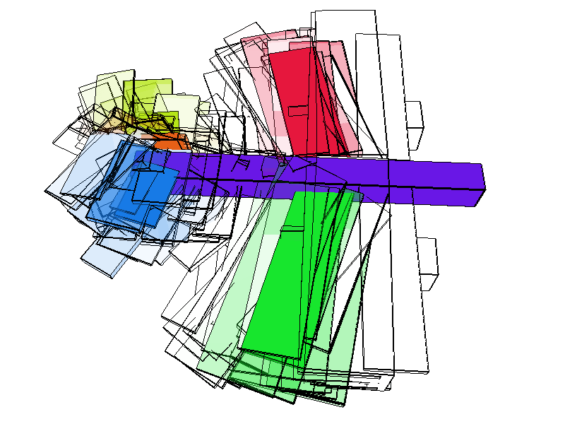

Probabilistic Part Relations
Part parameters
Local coordinates + Scale
Pairwise relations
Gaussian distributions of relative pose, height, and scale
Fixed
Notes:
We represent parts based on local coordinates and scales.
Their probabilistic relations are defined as a Gaussian distribution of their *relative* poses, heights, and scales.
Since our part relations are defined based on the *relative* poses, the missing parts can be recovered in the inference step based on the other observed parts.
In the training step, we learn these relations for each category of 3D models.
The figure on the bottom illustrates the distribution of the part arrangements according to the fixed parts denoted by violet color. Higher intensity means higher probability.

Slide 17




Probabilistic Part Relations
Part parameters
Local coordinates + Scale
Reflectional and rotational partial symmetries
On either a single part and/or pairs of parts.
e.g. Reflectional symmetry: back, seat, armrests (pairs). Rotational symmetry: column, legs.
Notes:
Symmetry relations including reflectional and rotational symmetries are also defined across multiple parts.
These symmetries are predicted in the inference step not only for completing the shape, but also for providing higher-order information in the optimization, which complements the previous pairwise relations.

Slide 18
Outline
Probabilistic shape model
$$⋯$$
Training
A collection of 3D models with part annotations
Input
Output
Inference
Partial scan data
Input
Output
Part/symmetry structure including missing parts
Notes:
(6m 10s)
Now let me explain the inference step.

Slide 19




Inference
Segmentation
Labeling
Structure Estimation
Missing Parts Prediction
Discrete
Continuous
Notes:
In the inference step, we solve multiple problems simultaneously including segmentation, labeling, structure estimation, and missing parts prediction.
This joint optimization problem is challenging in that not only we have a number of variables to be optimized,
[ANIMATION]
but also discrete *and* continuous variables are mixed in our formulation.

Slide 20














Inference Pipeline
Input Data
Initialization
Part Labels & Orientations Prediction
Point Segmentation
Part Pose Optimization
Additional Candidate Generation
Final Result
Energy function
$$E$$
$$=$$
$$E_{pnt}$$
$$+$$
$$E_{smooth}$$
$$+$$
$$E_{SMD}$$
$$+$$
$$E_{pair}$$
$$+$$
$$E_{symm}$$
Point-level
Part-level
Notes:
To tackle this challenge, we propose the following inference pipeline.
[ANIMATION]
We propose an energy function which is designed to capture all aspects including low-level geometric cues and part-level regularizations.
The point-level terms include per-point classification scores and segmentation smoothness, while the part-level terms include distance between points and parts, pairwise part relations, and partial symmetry.
Let me explain each step in the pipeline briefly.

Slide 21
Inference Pipeline
Input Data
Initialization
Part Labels & Orientations Prediction
Point Segmentation
Part Pose Optimization
Additional Candidate Generation
Final Result
Notes:
From the given partial scan data (next slide),

Slide 22
Inference Pipeline
Input Data
Initialization
Part Labels & Orientations Prediction
Point Segmentation
Part Pose Optimization
Additional Candidate Generation
Final Result
Clustering
Initialization
Notes:
We first cluster points which have high classification scores for the same part.
And based on their bounding boxes, we create initial parts.

Slide 23








Inference Pipeline
Input Data
Initialization
Part Labels & Orientations Prediction
Point Segmentation
Part Pose Optimization
Additional Candidate Generation
Final Result
Conditional Random Field (CRF)
CRF Node: Part
$$E_{pnt}$$
$$+$$
$$E_{smooth}$$
$$+$$
$$E_{SMD}$$
Unary Term
$$+$$
$$E_{pair}$$
$$+$$
$$E_{symm}$$
Binary Term
Part Label & Orientation Predictions
Notes:
Then, we assign labels to parts using a Conditional Random Field.
Here, parts become CRF nodes, part labels and their orientations become CRF labels,
and point classifiers and part relations become unary and binary energy terms respectively.

Slide 24







Inference Pipeline
Input Data
Initialization
Part Labels & Orientations Prediction
Point Segmentation
Part Pose Optimization
Additional Candidate Generation
Final Result
Conditional Random Field (CRF)
CRF Node: Point
$$E_{pnt}$$
$$+$$
$$E_{smooth}$$
$$+$$
$$E_{SMD}$$
Unary Term
Binary Term
Unary Term
$$+$$
$$E_{pair}$$
$$+$$
$$E_{symm}$$
Point Segmentation
Notes:
In the next step, we segment points using another CRF formulation.
Now points are CRF node, and point classifiers and distance between points and parts become unary energy terms.
And the segmentation smoothness is used as a binary term.

Slide 25




Inference Pipeline
Input Data
Initialization
Part Labels & Orientations Prediction
Point Segmentation
Part Pose Optimization
Additional Candidate Generation
Final Result
ICP-inspired Nonlinear Optimization
$$E_{pnt}$$
$$+$$
$$E_{smooth}$$
$$+$$
$$E_{SMD}$$
$$+$$
$$E_{pair}$$
$$+$$
$$E_{symm}$$
Part Pose Optimization
Notes:
In the next step, we optimize all continuous part and symmetry parameters.
Basically we leverage an ICP-inspired procedure by minimizing the distance between points and parts.
But since other energy terms such as pairwise relations and partial symmetry are non-linear,
we optimize the parameters iteratively using an interior point algorithm.

Slide 26



Inference Pipeline
Input Data
Initialization
Part Labels & Orientations Prediction
Point Segmentation
Part Pose Optimization
Additional Candidate Generation
Final Result
$$E_{pnt}$$
$$+$$
$$E_{smooth}$$
$$+$$
$$E_{SMD}$$
$$+$$
$$E_{pair}$$
$$+$$
$$E_{symm}$$
Additional Candidate Generation
Notes:
Finally, we recover the missing parts based on the relations from the observed parts.
[ANIMATION]
Each observed part generates a hypothesis for missing parts,
[ANIMATION]
And when we go back to the part labeling step, only one of the candidates is selected for each part.

Slide 27
Inference Pipeline
Input Data
Initialization
Part Labels & Orientations Prediction
Point Segmentation
Part Pose Optimization
Additional Candidate Generation
Final Result
Notes:
After iterating the optimization pipeline, we converge to the final part and symmetry structure.

Slide 28

Completion Strategy
Notes:
(8m 40s)
Now we have access to a complete structure estimated, which is subsequently used for the shape completion.

Slide 29
Completion Strategy
Input
Notes:
Given the input point cloud, (next slide)

Slide 30

Completion Strategy
Input → Symmetry
Reflectinal Symmetry
Rotational Symmetry
Notes:
Our completion strategy is to first fill in the missing area by copying and pasting the symmetric counterparts, (next slide)

Slide 31
Completion Strategy
Input → Symmetry → Database
Back
Armrest
Seat
Legs
Notes:
And, the rest of area is also filled by looking up similar shapes in the database for each part, and deforming them to fit into the given input point cloud.
So, the final output provides a fully complete result like this.

Slide 32


Qualitative Results
Input
Completion
Notes:
(9m 15s)
Now let me show some of our completion results.
In this example, legs are reconstructed by symmetry, but the seat part is mostly recovered from the database.

Slide 33


Qualitative Results
Input
Completion
Notes:
Here the leg part is reconstructed by combining both symmetry and the database.
Particularly In this case, it is very hard to know that there is a rotation symmetry on the leg if there is no prior information given.

Slide 34


Qualitative Results
Input
Completion
Notes:
In the case of this airplane, most of the missing area is reconstructed based on symmetry.
The reflection symmetry is detected even though there is only very weak evidence for symmetry in the input data.
Some other details are reconstructed from the database.

Slide 35


Qualitative Results
Input
Completion
Notes:
This is the another example for a table.
The details on both the top and leg parts are recovered by integrating both symmetry and database priors.

Slide 36


Qualitative Results
Input
Completion
Notes:
In this bicycle case, some missing areas on wheels are recovered by detecting rotational symmetry.

Slide 37
Quantitative Evaluation
Benchmark dataset
Synthesized dataset containing depth maps generated from 481 shapes in 5 classes
Tested each data based on leave-on-out cross validation
Benchmark available on: http://cs.stanford.edu/~mhsung/projects/structure-completion/
Notes:
(10m 20s)
For quantitative evaluation, we provide a benchmark dataset which includes synthesized depth images generated from 481 shapes in 5 classes.
The depth images are created by randomly choosing viewpoints around the object.

Slide 38




Evaluation Metric
Output
Ground Truth
Accuracy
Completeness
Far
Close
Notes:
Let me explain our evaluation metrics.
The left one is the result of completion from partial input data, and the right one is the ground truth shape.
[ANIMATION]
Our first metric is accuracy, which measures, what portion of the output point cloud is accurately reconstructed compared to the ground truth.
This figure illustrates the distance from the output to the ground truth,
[ANIMATION]
and the color goes to red as the distance is farther.
[ANIMATION]
The next measure is completeness, which measures, what portion of the ground truth is reconstructed in the output.

Slide 39



Evaluation Metric
Symmetry-only Output
Ground Truth
Accuracy
Completeness
Low
High
Notes:
For comparison, we also show some other cases when we use only symmetry *or* database priors in completion.
This is the same chair as the previous one, but it is the result only when using symmetry.
Obviously, the accuracy is high since we use only the input data itself as a source.
[ANIMATION]
But here the completeness is low because some missing areas cannot be filled when using symmetry only.

Slide 40



Evaluation Metric
Database-only Output
Ground Truth
Accuracy
Completeness
Low
High
Notes:
When using database-only,
We can reconstruct a fully complete shape by assembling parts from the database.
[ANIMATION]
But the retrieved shapes from the database might not exactly be the same as the input, so the accuracy cannot be as high as the previous case.

Slide 41





Comparison
Input
Symmetry-only Accuracy
Database-only Accuracy
Final Output Accuracy
Notes:
This is the other case showing the comparison of symmetry-only, database-only, and final results.
[ANIMATION]
The symmetry-only completion still has some missing areas on the seat, which leads to low completeness.
[ANIMATION]
The database-only completion is not exactly the same as the ground truth particularly on the armrests, which results in low accuracy.
[ANIMATION]
But our final output combining both symmetry and database shows a better result in terms of both accuracy and completeness.

Slide 42





Comparison
Input
Symmetry-only Accuracy
Database-only Accuracy
Final Output Accuracy
Notes:
This is another example for an airplane.
The symmetry-only result couldn’t recover all details, and the database-only result deviates a little bit from the ground truth.
But our final output combining *both of them* better reconstruct all missing areas while preserving the original geometry.

Slide 43





Comparison to Previous Work
Input
[Podolak et. al. 2006] Symmetry-based
Ours
Notes:
(12m 40s)
We also compare our method with other previous work.
The Podolak et. al’s method is the state-of-the-art algorithm detecting reflectional symmetry from the given 3D point cloud by sampling symmetry transforms.
This method works well for complete shapes,
But when the input is partial data, and the evidence of symmetry is very weak, it fails to detect the desired symmetry.
And instead of that, it can also result in the wrong hypothesis since this method entirely relies on the input data.
However in the same case, our method detected the correct symmetry based on the given prior of symmetry and the estimated structure.

Slide 44





Comparison to Previous Work
Input
[Shen et. al. 2012] Retrieval-based
Ours
Notes:
This is another comparison with Shen et. al.’s method.
Shen et. al.’s method is a retrieval-based shape recovery algorithm.
The goal of their method is to produce a good-looking 3D model, but it is not necessarily similar to the scanned shape, particularly when the database is limited.
Comparing to this, our method not only use the database in completion, but also leverage the given input point cloud as mush as possible.
Therefore, our completion result is more similar to the original shape.

Slide 45
Quantitative Evaluation
Ours
Completeness
[Podolak et al. 2006]
Baseline Completeness
[Shen et al. 2012]
Accuracy
Notes:
This plot shows the overall statistics of our quantitative evaluation.
The X axis is accuracy, and Y axis is completeness,
These three dots indicate the average accuracy and completeness of all experiments for the three methods.
The dashed line shows the average completeness when we do nothing for the partial input data.
As shown here, podolak et. al’s method using symmetry shows the highest accuracy, which is not surprising, but its completeness is close to the baseline,
which means that their output is actually not very different with the partial input data.
And the shen et. al.’s method using the database shows less accurate results.
Our method shows the highest completeness with a relatively small drop in accuracy.

Slide 46










Real Scans
Input
Output
Notes:
(14m 45s)
We also tested our method with real scan data captured by Kinect.
Despite noise from depth sensors and some completely missing parts, our method successfully reconstructed the entire shapes.
Such reconstructed 3D geometry enables robots to understand the 3D real space based on partial observations, and lets the virtual objects interact with the hidden parts of the real objects in the augmented reality applications.

Slide 47










Real Scans
Input
Output
Notes:
These are some more examples of Kinect scan completion.

Slide 48










Real Scans
Input
Output

Slide 49




Limitations
Ground Truth
Estimated Structure
Input
Completion
Notes:
This is an our failure example.
Because of the ambiguity of partial symmetry, in some special cases, our method can incorrectly interpret the input data as shown here.

Slide 50
Summary & Conclusion
A structure inference algorithm which simultaneously segments, labels and estimates parts and symmetries
A probabilistic shape model for analyzing partial scans
A shape completion method combining symmetry and database sources
A benchmark for evaluation
Notes:
(15m 35s)
In summary,
First, we introduced
Also for that, we introduced
We proposed
And at last, we provided

Slide 51






Future Works
Interactive scanning
Producing multiple possible completions
Guiding users and robots in scanning
[Xu et. al. Siggraph Asia 2015] Autoscanning For Coupled Scene Reconstruction And Proactive Object Analysis
Notes:
In the future, we plan to extend our framework for enabling users or robots to interact with our completion process.
[ANIMATION]
For instance, we’re going to develop interfaces so that when multiple interpretations are available from the partial input data, the user can provide an input choosing one of the options.
[ANIMATION]
Also, potentially the output of our framework can guide the users and robots in scanning to efficiently scan the unobserved area.
This topic is related to *this* auto-scanning paper, which will be presented in this session later.

Slide 52
Future Works
Interactive scanning
Producing multiple possible completions
Guiding users and robots in scanning
Technical improvements
Hierarchical scene understanding
Leveraging color information
Producing high-quality details
Notes:
Moreover, we plan to extend our framework to complete *3D scenes* with a *hierarchical* representation for part relations.
We’re also going to leverage color information as well as the depth images, and to produce higher-quality outputs for a broader range of applications.

Slide 53


Acknowledgement
NSF grants CCF 1011228
DMS 1228304
AFOSR grant FA9550-12-1-0372
ONR MURI grant N00014-13-1-0341
A Google Focused Research Award
The Korea Foundation and Advanced Studies
The Max Planck Center for Visual Computing and Communications
Stanford Bio-X travel Subsidy
Benchmark website: http://cs.stanford.edu/~mhsung/projects/structure-completion/
Notes:
Our code and data is available on this website.
Thank you for your attention.
(17m 00s)

Slide 54
Thank you
Data-Driven Structural Priors for Shape Completion

Slide 55


Inference Pipeline
Input Data
Initialization
Part Labels & Orientations Prediction
Point Segmentation
Part Pose Optimization
Additional Candidate Generation
Final Result
Conditional Random Field (CRF)
The orientation is further refined in
Continuous space later.
CRF Labels = $\{$Part Labels $×$ XYZ Permutations$\}$
…
Part Label & Orientation Predictions
Notes:
Then, we assign labels to parts using a Conditional Random Field.
Here, parts become CRF nodes, part labels and their orientations become CRF labels,
and point classifiers and part relations become unary and binary energy terms respectively.

Slide 56



Visibility
Missing parts are added only when they are located in invisible areas.

Slide 57




Symmetry Estimation
Our method (green bars) does not have large-scale errors, but suffers from smaller-scale errors.
Fine-scale errors
Fine-scale errors
Symmetry detection error for airplane Dataset

Slide 58
Timing
Training step
Computing local geometric features: 3min / shape
Building a classifier: 3min
Inference step
Segmentation & labeling: 0.6min
Part and symmetry structure estimation: 3.4min

